Slide 1
2019 Year-End Holiday Assignment

Slide 2
2019 Year-End Holiday Assignment (H2)
In its September 2013 Recent Economic Developments Statement, the Monetary Authority of Singapore noted that inflation was expected to rise moderately. Strong GDP growth in Q2 2013 was mainly due to increased output in the manufacturing and trade-related service sectors with a slowing of growth in private consumption. There was expected to be continued strong wage pressure from persistent tightness in the labour market caused by shortages in labour supply accompanied by steady expansion in demand for goods and services from the US, Japan and the Eurozone.
Source: Recent Economic Developments in Singapore, MAS, 5 Sep 2013
Explain how the above mentioned factors might have caused the rate of inflation to rise in Singapore. [10]
Discuss whether exchange rate appreciation should remain the most important policy instrument in controlling the rate of inflation in the Singapore economy. [15]

Slide 3
2019 Year-End Holiday Assignment (H2)
Instructions:
1. Write the essay
Attempt the essay in 45 min (self-time).
If you are not able to complete the answer, draw a line across the page at the 45 min mark and continue. Record the end time.
2. Read the suggested answer and watch the reflection video (SLS)
3. Mark your answer
With guidance from the suggested answer and reflection video, mark your answer using the CARD framework.
4. Reflect on your answer using the Reflection Worksheet
Identify the strengths and gaps in your answer.
Commit to 3 specific action you can take to close the gaps.
50%
50%

Slide 4
 | Meaning of the term | Guiding Questions
Clarity | Meaning can be grasped and clearly understood; free from ambiguity. | Are the main points clearly stated? Is the analysis coherent? Are the sentences kept short & simple? Are examples & diagrams clearly explained or drawn?
Accuracy + Precision | Exact to the necessary level of detail. Specific use of economic content & language. | Are the economic concepts correct & appropriately applied? Are the economic terms correctly used (e.g. QD vs DD)? Are the definitions precise & diagrams correctly drawn/labelled?
Relevance + Significance | Logical connection between economic analysis & question requirement. Level of importance of ideas raised. | Is there a logical connection between the economic analysis and the question requirement / context? Are appropriate examples & diagrams used to illustrate the point? Is the relative importance of the ideas considered?
Depth + Breadth | Layered analysis with comprehensive & thorough elaboration. Multiple viewpoints or perspectives. | Does the answer probe beyond the superficial layers to consider the different components? Is the analysis thoroughly elaborated? Does the answer consider alternative viewpoints or perspectives? Are there any limitations/assumptions involved? Are these assumptions always valid?

Slide 5
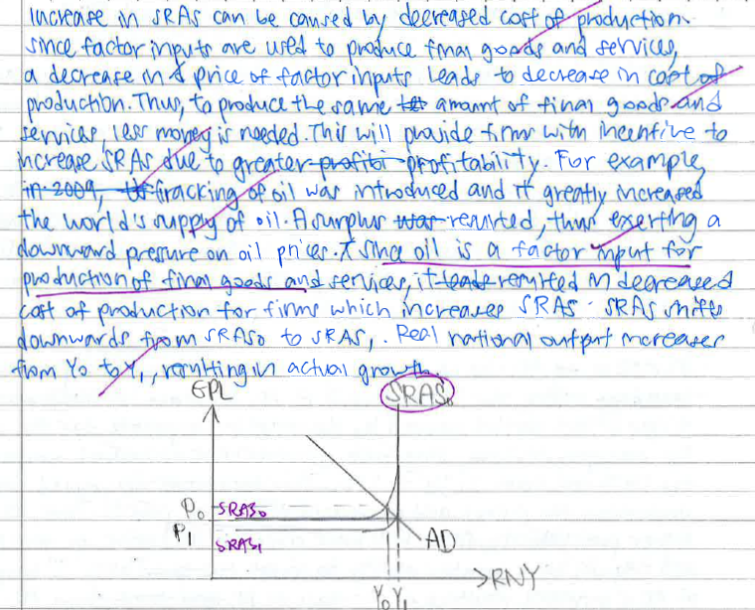
What you should do
C+
D+
(real world examples)
R+
(chose relevant and impt FOP)
A-
(inaccurate labelling of diagram)

Slide 6
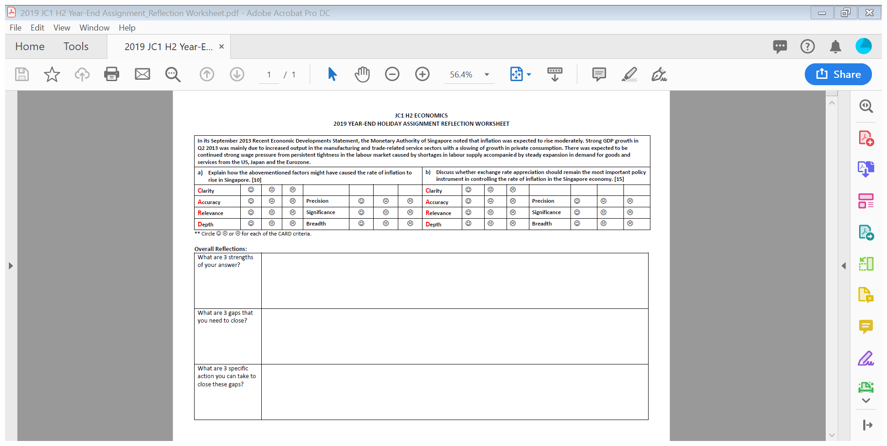

Slide 7
What and When to Submit
1. Self-marked work
We are NOT looking for corrections / correct answer
Show signs of ability to pick up gaps in your learning
E.g. Insufficient Clarity in your writing (go round and round but did not actually say what your point was)
E.g. Insufficient Depth (unable to use real world examples or go beyond textbook explanations to contextualise your points)
2. Reflection worksheet
Be as precise as possible in defining the measures to take.
Submit your self-marked assignment and reflection worksheet during your first tutorial in Jan 2020.

Slide 8
2019 Year End Holiday Assignment (H1) Instructions
If you are intending to / confirm downgrading,
Attempt Practice Papers (Case-study based)
Uploaded on SLS (access using the H2 link)

